Slide 1

Algorithm Analysis IT-2101
Dr. Mohammad Abu Yousuf
yousuf@juniv.edu

Slide 2
Graph

Slide 3
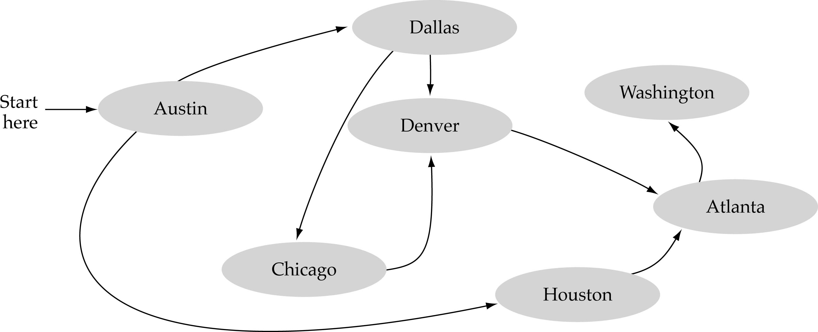
What is a graph?
A data structure that consists of a set of nodes (vertices) and a set of edges that relate the nodes to each other
The set of edges describes relationships among the vertices

Slide 4
Formal definition of graphs
A graph G is defined as follows:
G=(V,E)
V(G): a finite, nonempty set of vertices
E(G): a set of edges (pairs of vertices)

Slide 5
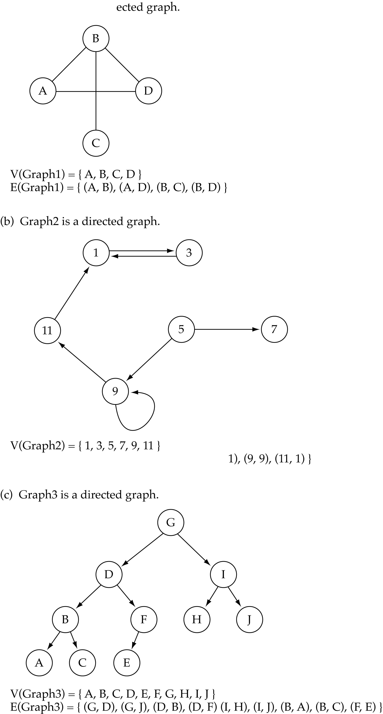
Directed vs. undirected graphs
When the edges in a graph have no direction, the graph is called undirected

Slide 6
Directed vs. undirected graphs (cont.)
When the edges in a graph have a direction, the graph is called directed (or digraph)
Warning: if the graph is directed, the order of the vertices in each edge is important !!
E(Graph2) = {(1,3) (3,1) (5,9) (9,11) (5,7)

Slide 7
Trees vs graphs
Trees are special cases of graphs!!

Slide 8
Graph terminology
Adjacent nodes: two nodes are adjacent if they are connected by an edge
Path: a sequence of vertices that connect two nodes in a graph
Complete graph: a graph in which every vertex is directly connected to every other vertex
5 is adjacent to 7
7 is adjacent from 5

Slide 9
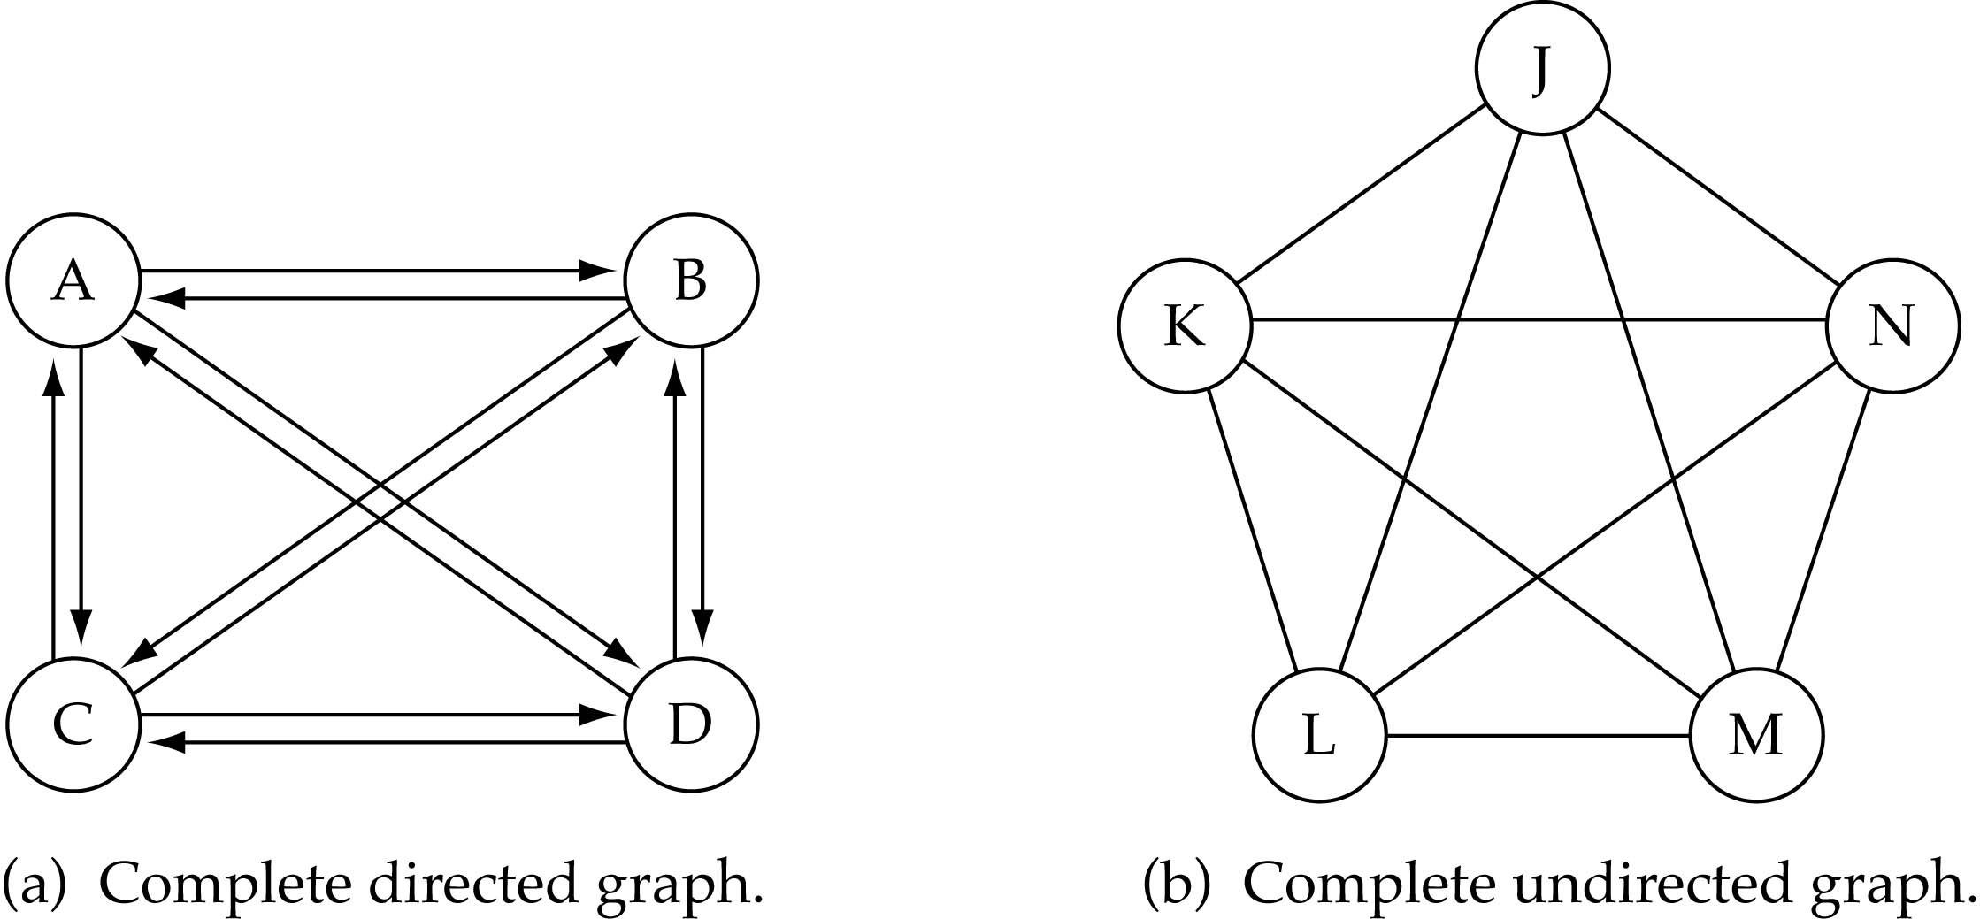
Graph terminology (cont.)
What is the number of edges in a complete directed graph with N vertices?
N * (N-1)

Slide 10
Graph terminology (cont.)
What is the number of edges in a complete undirected graph with N vertices?
N * (N-1) / 2

Slide 11
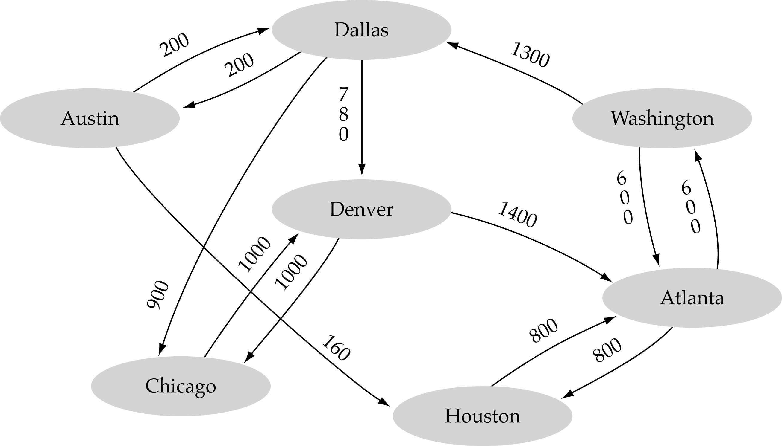
Graph terminology (cont.)
Weighted graph: a graph in which each edge carries a value

Slide 12
Graph Representation
For graphs to be computationally useful, they have to be conveniently represented in programs.
There are two computer representations of graphs:
Adjacency matrix representation
Adjacency lists representation

Slide 13
Adjacency Matrix Representation
In this representation, each graph of n nodes is represented by an n x n matrix A, that is, a two-dimensional array A
The nodes are (re)-labeled 1,2,…,n
A[i][j] = 1 if (i,j) is an edge
A[i][j] = 0 if (i,j) is not an edge

Slide 14
Example of Adjacency Matrix
1
0
0 1 0 1 0
0 0 1 0 0
0 0 1 0 0
1 0 0 0 0
0 0 0 1 0
A =
2
4
3

Slide 15
Another Example of Adj. Matrix
Re-label the nodes with numerical labels
Mary 0
Helen 1
0 0 0 0 0 0
0 0 0 0 0 0
1 1 0 0 1 1
1 1 0 0 1 1
1 1 0 0 0 0
1 1 0 0 0 0
A =
Joe 3
John 2
Tom 4
Paul 5

Slide 16
Pros and Cons of Adjacency Matrices
Pros:
Simple to implement
Easy and fast to tell if a pair (i,j) is an edge: simply check if A[i][j] is 1 or 0
Cons:
No matter how few edges the graph has, the matrix takes O(n²) in memory

Slide 17
Adjacency Lists Representation
A graph of n nodes is represented by a one-dimensional array L of linked lists, where
L[i] is the linked list containing all the nodes adjacent from node i.
The nodes in the list L[i] are in no particular order

Slide 18
Example of Linked Representation
L[0]: empty
L[1]: empty
L[2]: 0, 1, 4, 5
L[3]: 0, 1, 4, 5
L[4]: 0, 1
L[5]: 0, 1
Mary 0
Helen 1
Joe 3
John 2
Tom 4
Paul 5

Slide 19
Graph implementation (cont.)
Linked-list implementation
A 1D array is used to represent the vertices
A list is used for each vertex v which contains the vertices which are adjacent from v (adjacency list)

Slide 20
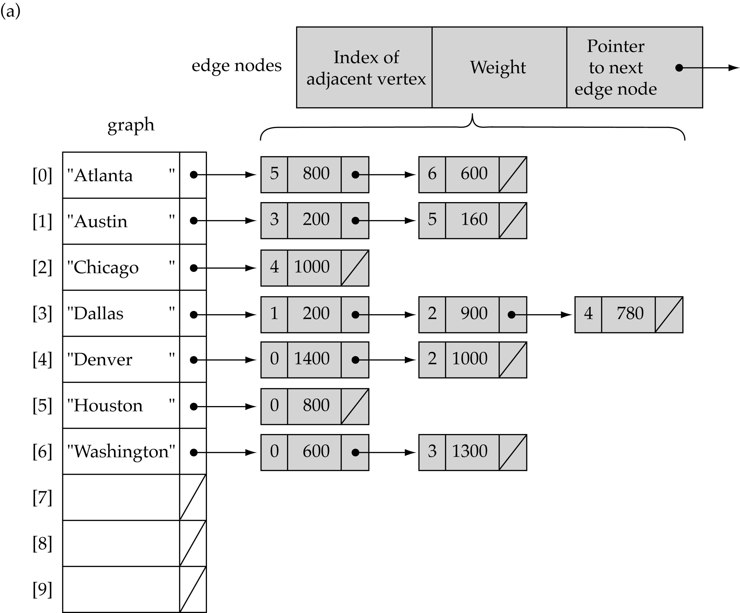
Linked-list implementation

Slide 21
Graph Traversal Techniques
There are two standard graph traversal techniques:
Depth-First Search (DFS)
Breadth-First Search (BFS)

Slide 22
Graph Traversal (Contd.)
In both DFS and BFS, the nodes of the undirected graph are visited in a systematic manner so that every node is visited exactly one.
Both BFS and DFS give rise to a tree:
When a node x is visited, it is labeled as visited, and it is added to the tree
If the traversal got to node x from node y, y is viewed as the parent of x, and x a child of y

Slide 23
Depth-First Search
DFS follows the following rules:
Select an unvisited node x, visit it, and treat as the current node
Find an unvisited neighbor of the current node, visit it, and make it the new current node;
If the current node has no unvisited neighbors, backtrack to the its parent, and make that parent the new current node;
Repeat steps 3 and 4 until no more nodes can be visited.
If there are still unvisited nodes, repeat from step 1.

Slide 24
Illustration of DFS
0
1
0
2
1
4
4
9
10
5
7
2
11
8
5
9
6
7
11
6
Graph G
8
10
DFS Tree

Slide 25
Breadth-First Search
BFS follows the following rules:
Select an unvisited node x, visit it, have it be the root in a BFS tree being formed. Its level is called the current level.
From each node z in the current level, in the order in which the level nodes were visited, visit all the unvisited neighbors of z. The newly visited nodes from this level form a new level that becomes the next current level.
Repeat step 2 until no more nodes can be visited.
If there are still unvisited nodes, repeat from Step 1.

Slide 26
Illustration of BFS
0
1
0
2
4
2
1
4
9
5
9
10
10
5
7
11
8
6
7
8
11
6
BFS Tree
Graph G

Slide 27
Illustration of BFS
Given a graph G =(V,E) and a distinguished source vertex s, breadth-first search systematically explores the edges of G to “discover” every vertex that is reachable from s.
It computes the distance (smallest number of edges) from s
to each reachable vertex. It also produces a “breadth-first tree” with root s that contains all reachable vertices.
For any vertex v reachable from s, the simple path in the breadth-first tree from s to corresponds to a “shortest path” from s to v in G, that is, a path containing the smallest number of edges.
The algorithm works on both directed and undirected graphs.

Slide 28
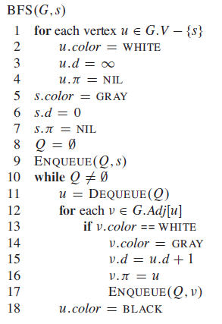
Illustration of BFS

Slide 29
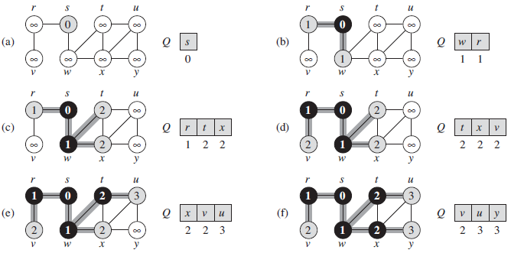
Illustration of BFS

Slide 30
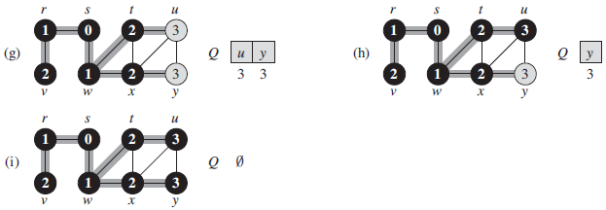
Illustration of BFS

Slide 31
Thank you

